Slide 1
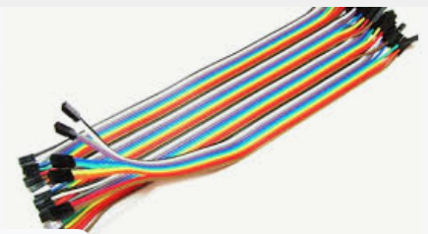
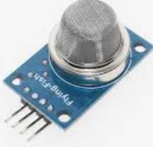
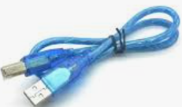
Reading data from Arduino serial port with python
Components to be used:
MQ-135
Arduino uno
USB Cable
Breadboard
Connecting wires

Slide 2
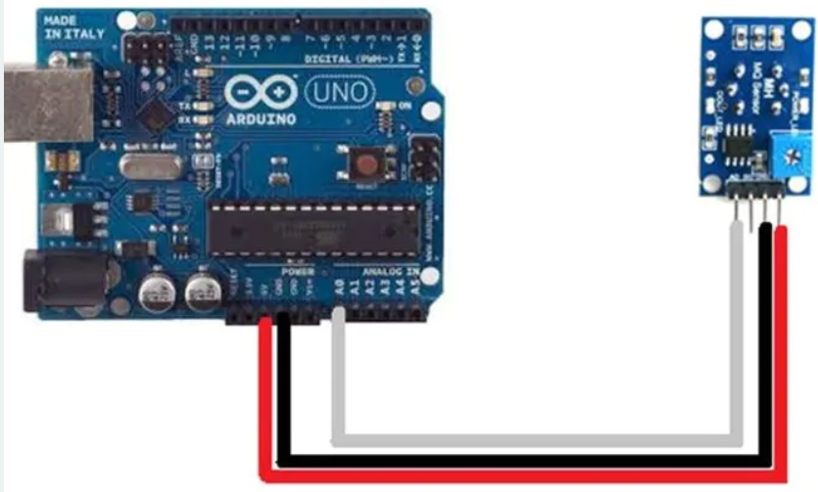
CIRCUIT DIAGRAM

Slide 3
Experiment procedures
1.Connect the circuit as shown by the above circuit diagram
2.Connect microcontroller into your PC
3.Type the Program CODE into computer connected on arduino
4.Compile and download the program into microcontroller
Open anaconda Jupyter notebook
Write a python script to read data from MQ-135 gas sensor via Arduino serial port

Slide 4
LAB Session
Let connect the circuit diagram.

